Slide 1
Structure in C programming
Md. Alamgir Hossain
Senior Lecturer,
Dept. of CSE, Prime University, Dhaka
Mail: alamgir.cse14.just@gmail.com

Slide 2

Structure in C
A structure is a user defined data type in C/C++.
A structure creates a data type that can be used to group items of possibly different types into a single type.

Slide 3
Why Structure in C
Lets say we need to store the data of students like student name, age, address, id etc.
One way of doing this would be creating a different variable for each attribute, however when you need to store the data of multiple students then in that case, you would need to create these several variables again for each student.
This is such a big headache to store data in this way.
We can solve this problem easily by using structure.
We can create a structure that has members for name, id, address and age and then we can create the variables of this structure for each student.

Slide 4
Creating a Structure in C
We use struct keyword to create a structure in C. The struct keyword is a short form of structured data type.
Syntax:
struct struct_name{
DataType member1_name;
DataType member2_name;
DataType member3_name;
…
};

Slide 5
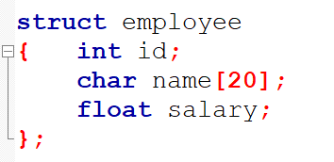
Example

Slide 6
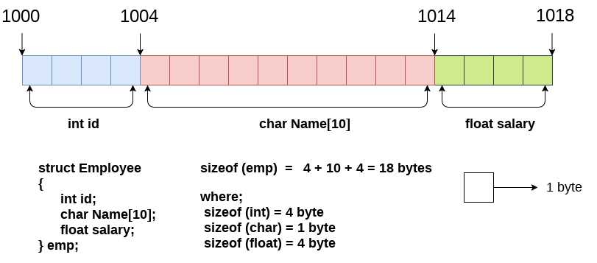
Memory Allocation of the Structure Employee
Here, struct is the keyword; employee is the name of the structure; id, name, and salary are the members or fields of the structure.

Slide 7
Declaring Structure Variable
We can declare a variable for the structure so that we can access the member of the structure easily. There are two ways to declare structure variable:
By struct keyword within main() function
By declaring a variable at the time of defining the structure.

Slide 8
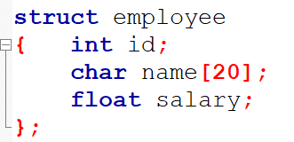
1st Approach
Now write given code inside the main() function.
struct employee e1, e2;
The variables e1 and e2 can be used to access the values stored in the structure.

Slide 9
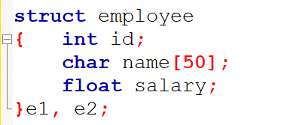
2nd Approach
Declaring variable at the time of defining the structure.
Which approach is good: If number of variables are not fixed, use the 1st approach. It provides you the flexibility to declare the structure variable many times.

Slide 10
Access Members of a Structure
There are two types of operators used for accessing members of a structure.
. Member operator
-> Structure pointer operator

Slide 11
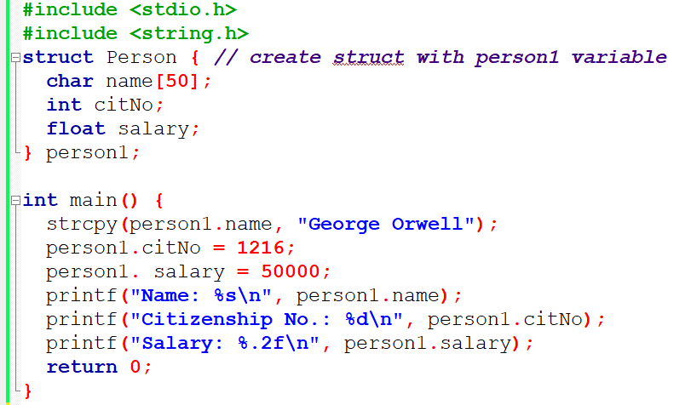
Example

Slide 12
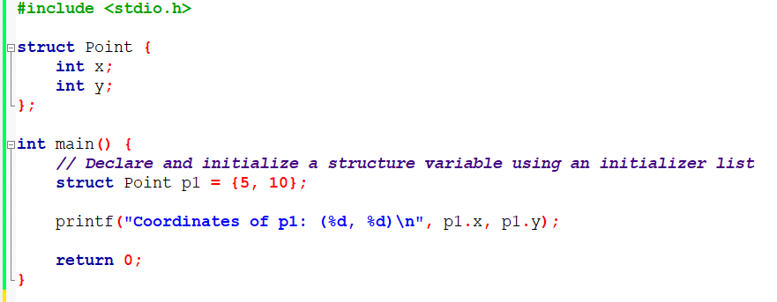
Declare and Initialize a Structure

Slide 13
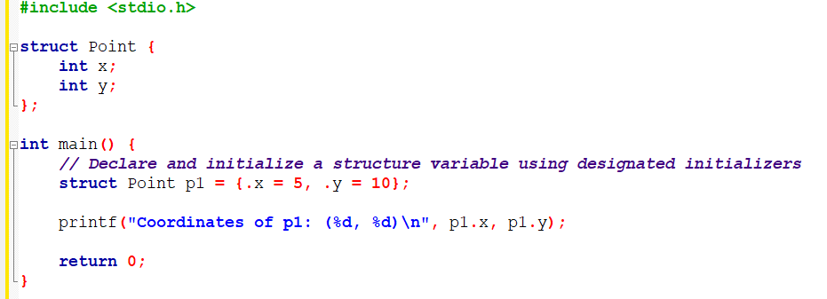
Declare and Initialize a Structure

Slide 14
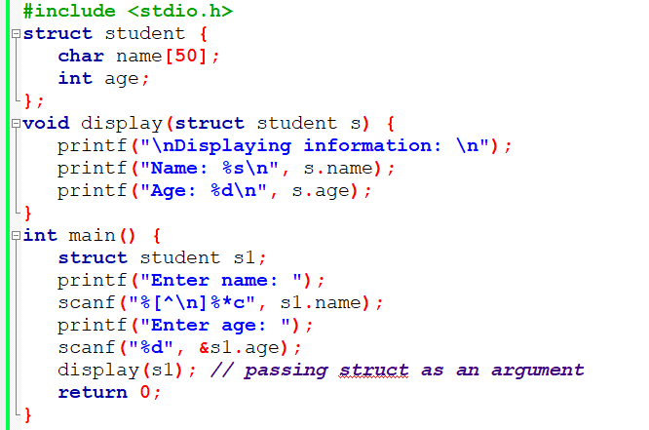
Pass Structures to a Function

Slide 15
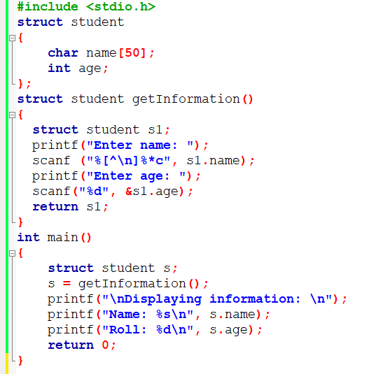
Return struct from a Function

Slide 16
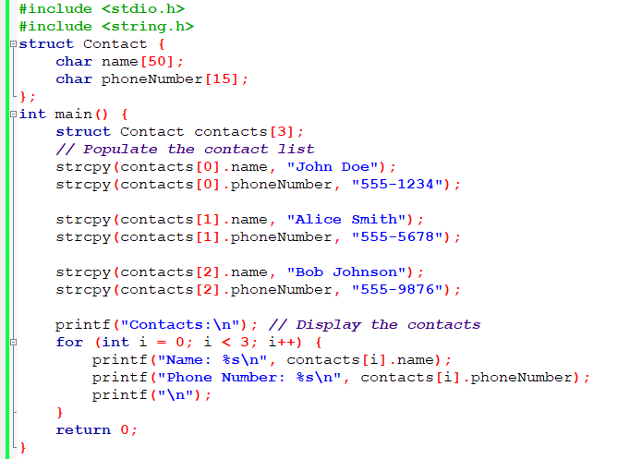
Manages a Contact list using Structures (Array)

Slide 17
Homework
***Define a “university” structure to store information about students, including their name, roll number, and cgpa.
Implement an input function that accepts an array of university structures and the number of students n, then reads the student data from standard input (usually from the keyboard).
Implement an output function that takes the same array and prints the stored data to standard output, formatting the name, roll number, and cgpa of each student in a tab-separated format.
Implement a “roll_sort” function that sorts the array of university structures in ascending order by the roll number using a simple bubble sort algorithm. Bubble sort works by repeatedly swapping adjacent elements that are in the wrong order, which in this case is done by comparing the roll numbers of the students.
In the main function, the program is set to work with 5 students as an example size (n = 5). It creates an array of university structures for the number of students, prompts for input, sorts the array by roll number, and then outputs the sorted array.

Slide 18
Thank You

